Slide 1
Physiology 115 Cell Physiology Spring 2015 term
Mitch Halloran, Ph.D.
Prepared especially for Life Chiropractic College West

Slide 2
Course Overview
Course Description
The structure and function of the cell and all its organelles are described, illustrating how life processes in the cell are reflected in the functioning of the whole body.
Topics covered in detail are:
structure and function of cell membranes
transport of material across membranes
protein structure and function
motility in cells (microfilaments and microtubules)
carbohydrates, cellular respiration
ATP, nucleic acids
protein synthesis
mitosis, meiosis

Slide 3
Course Overview
Prerequisites
None
Weekly Lecture Days & Times
Monday & Wednesday mornings
9:50 to 11:40
according to LCCW term calendar

Slide 4
Course Overview: Content
Required Text
Content from lectures
Recommended Texts
Marieb EN (2011) Human Anatomy & Physiology 10th Ed
ISBN-10: 0321695984 | ISBN-13: 978-0321695987
Becker WM (2011) The World of the Cell 8th Ed
ISBN-10: 0321716027 | ISBN-13: 978-0321716026
Raven P (2010) Biology 9th Ed ISBN-10: 0073532223 ISBN-13: 978-0073532226
All books on reserve in library

Slide 5
Instruction Details
Grading/Evaluation
Weekly Quiz (10%)
5 quizzes for course
Midterm Examination (30%)
one midterm in Week 5
covering all lecture content up to midterm date
Oral Presentation (10%)
Final Examination (50%)
one final in Week 11
covers lecture content AND student oral presentation content
Grades
90-100% | A
80-90% | B
70-80% | C
< 70% | F

Slide 6
Instruction Details
Examination assessment approach
multiple choice
modified essay
extended matching
short essay/answer

Slide 7
Oral Presentations
Presented in weeks 8 to 10
Students shall form groups (maximum 4/group) at start of term, then develop presentation on topic
Each presentation is 15 minutes, including setup and Q&A (be quick please)
Attendance required of all students for presentations
Presentation content will be part of final examination content!!
Attendees should participate in discussion

Slide 8
Oral Presentations On Topic
Topics of presentations must be relevant to course subjects (lecture topics)…some examples are
roles of different protein types in cell function
mitochondria: cell metabolism & its own genome
high carbohydrate & fat diet: its adverse effects
chromosomal theory of inheritance
human genome project
cloning
gene therapy

Slide 9
Oral Presentation Suggested Format
Your approach to the topic may be:
Introduction to topic which includes short historical background
Review of literature with selected but important reports highly descriptive of thesis
Recent advances in the field
Clinical correlations and significance of a basic science concept

Slide 10
Communication / Interaction
email: shalloran@lifewest.edu
phone: (916) 410-7133
office hours: Wednesdays 12-1 pm
office location: Room 147 (Adjunct Room)

Slide 11
Cell Structure & Function
Lecture 1

Slide 12
Goals of a Cell & Organism
Maintain its survival
Done by achieving a metabolic stability or homeostasis (not chemical equilibrium)
Perpetuate its kind (species)
Mechanisms for cellular longevity
Mechanisms for cellular / organismal dormancy
Mechanisms to create genetic diversity during sexual reproduction in order to adapt to changing environments

Slide 13
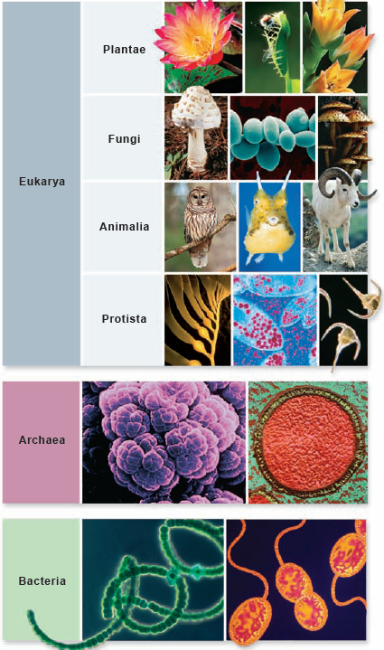
Biological World
Domains (Woese)
Archaea
Bacteria
Eukarya (eukaryotes)
Four kingdoms
uni- and multicellular organisms
} (prokaryotes)

Slide 14
Comparing The Domains
A Comparison of Some Properties of Bacterial, Archaeal, and Eukaryotic Cells*
 | Prokaryotes
Property | Bacteria | Archaea | Eukaryotes
Typical size | Small (1–5 µm) | Small (1–5 µm) | Large (10–100 µm)
Nucleus and organelles | No | No | Yes
Microtubules and microfilaments | Actin-like and tubulin-like proteins | Actin-like and tubulin-like proteins | Actin and tubulin proteins
Exocytosis and endocytosis | No | No | Yes
Cell wall | Peptidoglycan | Varies from proteinaceous to peptidoglycan-like | Cellulose in plants, fungi; none in animals, protozoa
Mode of cell division | Binary fission | Binary fission | Mitosis or meiosis plus cytokinesis
Typical form of chromosomal DNA | Circular, few associated proteins | Circular, associated with histone-like proteins | Linear, associated with histone proteins
RNA processing | Minimal | Moderate | Extensive
Transcription initiation | Bacterial type | Eukaryotic type | Eukaryotic type
RNA polymerase | Bacterial type | Some features of both bacterial, eukaryotic types | Eukaryotic type
Ribosome size and number of proteins | 70S with 55 proteins | 70S with 65 proteins | 80S with 78 proteins
Ribosomal RNAs | Bacterial type | Archaeal type | Eukaryotic type
Translation initiation | Bacterial type | Eukaryotic type | Eukaryotic type
Membrane phospholipids | Glycerol-3-phosphate + linear fatty acids | Glycerol-1-phosphate + branched polyisoprenoids | Glycerol-3-phosphate + linear fatty acids
from Table 4-1 in Hardin, Bertoin, Kleinsmith (eds.) Becker's World of The Cell, 8th Ed, 2012

Slide 15
Prokaryotes
Bacteria
Common features with eukaryotes
cytoplasm
plasma membrane
DNA organized as chromosome
Unique features
cell wall
capsule
pili
flagella
Missing features
nucleus & other membranous organelles

Slide 16
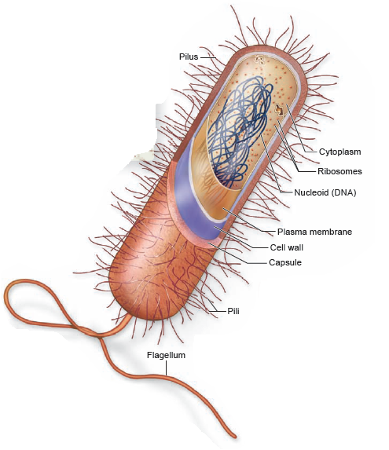
Generalized Bacterial Cell
Flagellum
motility
Pilus
attachment
exchange of genetic material with other bacteria
cell wall
integrity under stress (changes in osmolarity)
capsule
attachment
virulence

Slide 17
Eukaryotic Cells
Basics
plasma (cell) membrane
nucleus
cytoplasm
cytosol
organelles
Organelles
mitochondria
endoplasmic reticulum
Golgi complex
lysosomes (animals)
peroxisomes
chloroplasts (plants)
vacuole (plants)
primary & secondary walls (plants)

Slide 18
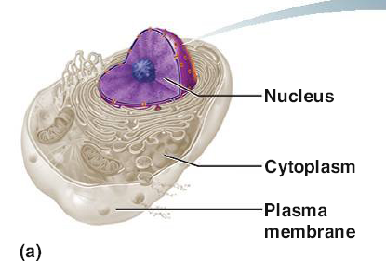
Eukaryote Basics Visualized
No cell wall
Organelle-rich cytoplasm

Slide 19
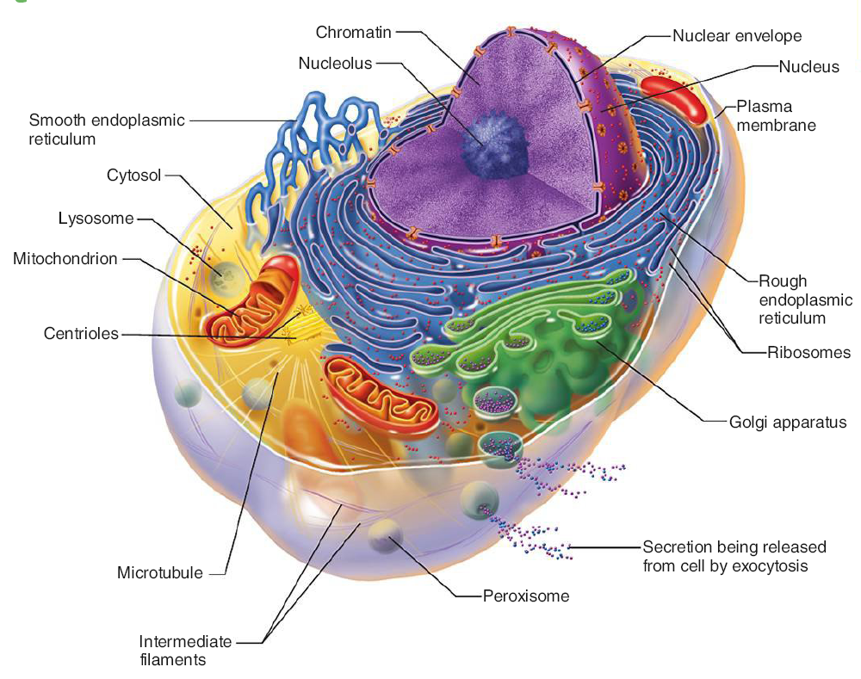
View of Animal Cell Features

Slide 20
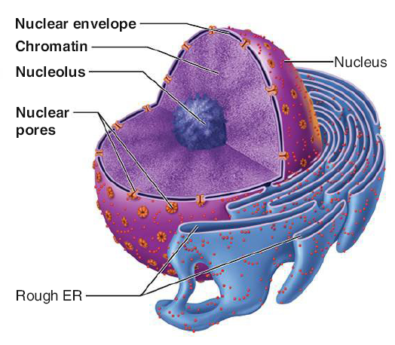
Detail of Nucleus & ER
Continuity of nuclear envelope with ER "endomembrane system"
Nuclear pores

Slide 21
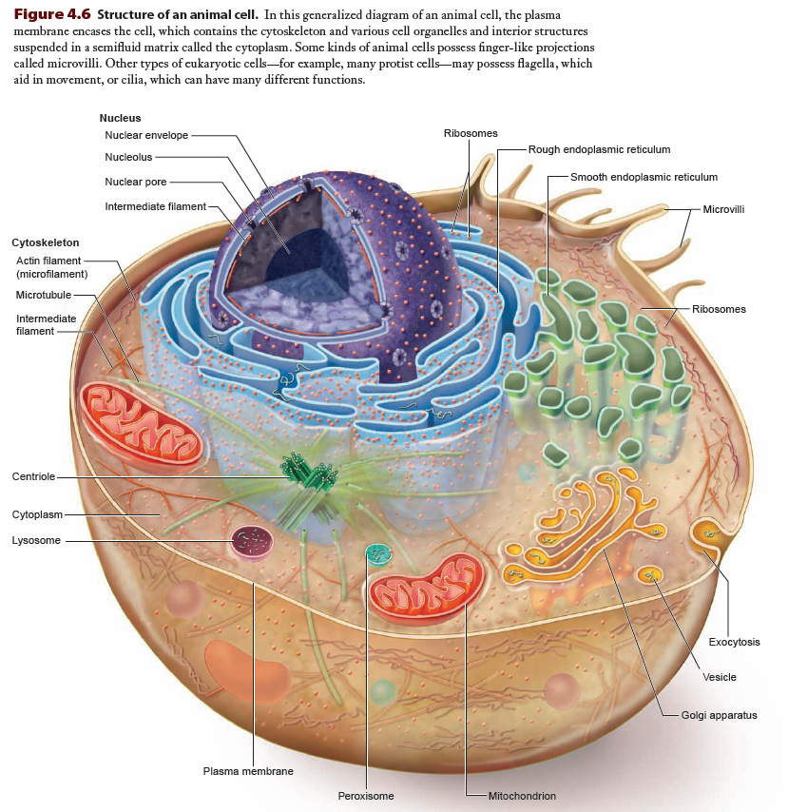

Slide 22
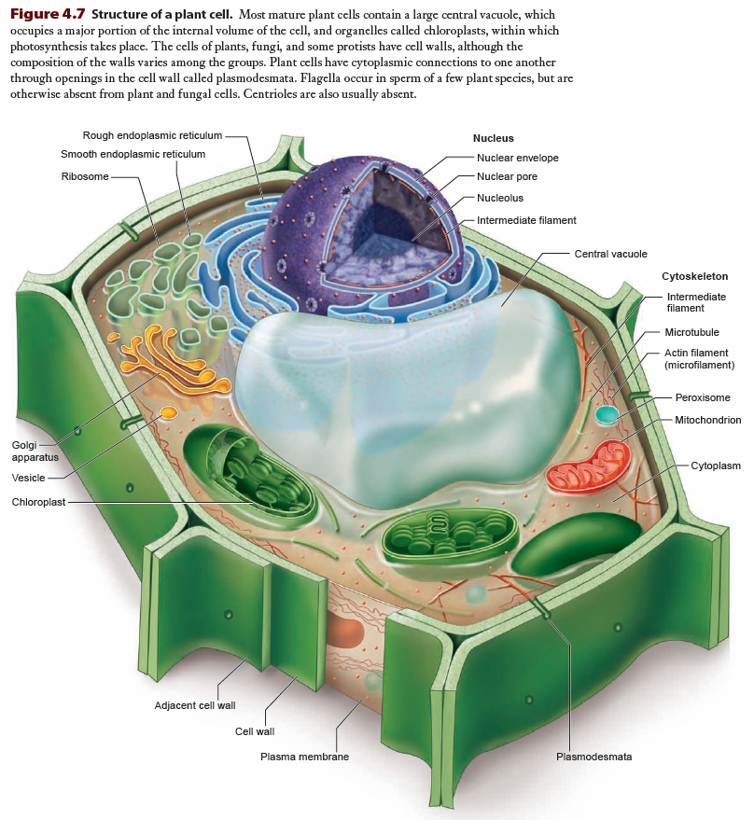

Slide 23
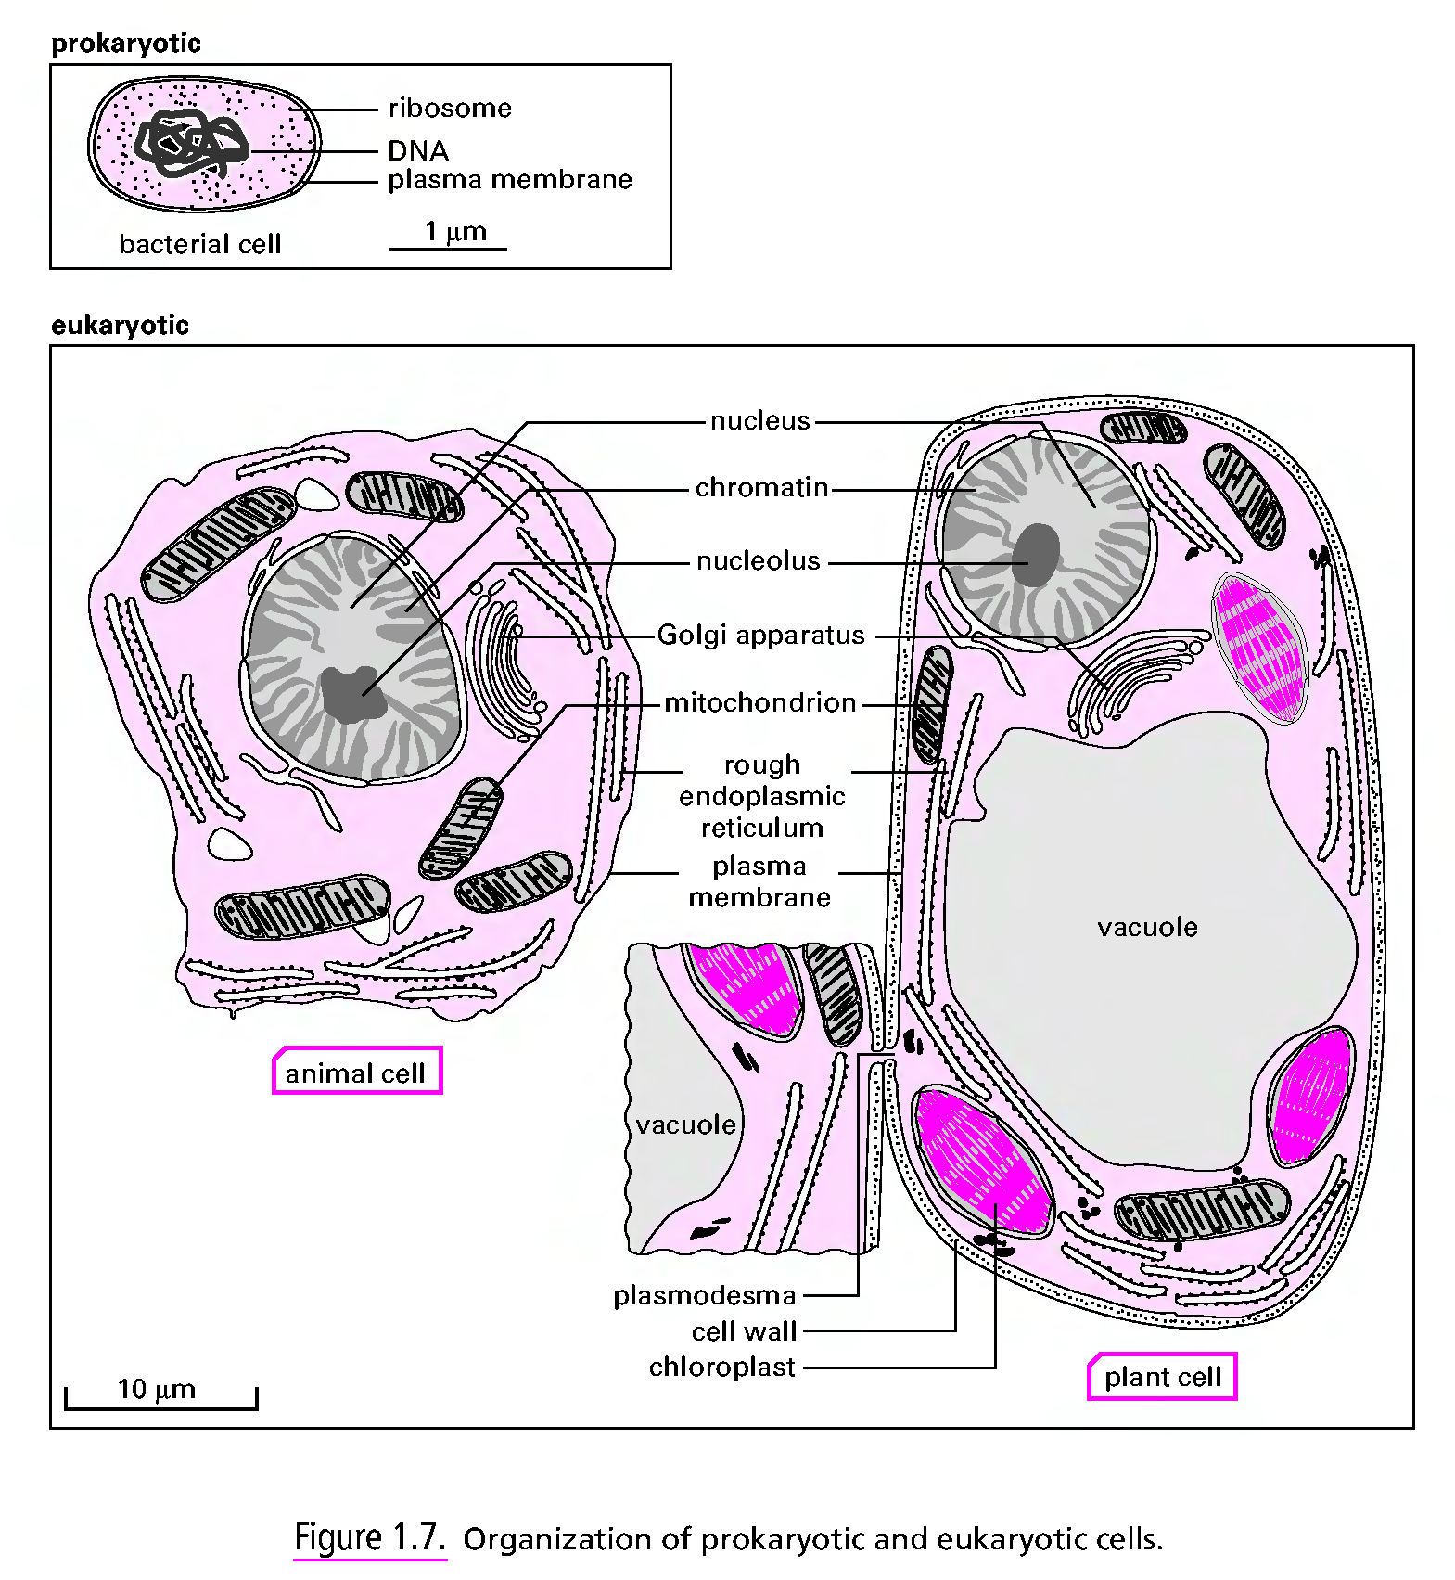

Slide 24
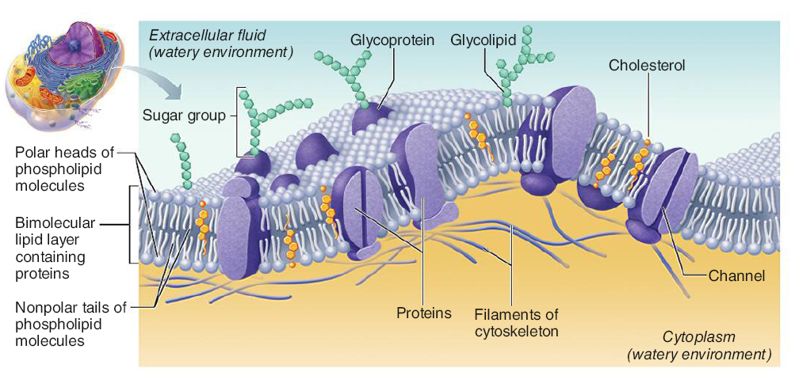
Animal Cell Plasma Membrane

Slide 25
Terms/Definitions/Descriptions
Cytoplasm
The cell contents bounded by the cell's plasma membrane and excluding the nucleus (for eukaryotes)
It is composed of cytosol and the cell's organelles
Cytosol
a viscous matrix composed of a water solvent and solutes that supports cell metabolism, structure and function
the solutes are small metabolites and large biomolecules: carbohydrates, lipids, amino acids, proteins
Organelle
definitions vary widely!!
minimum (safest and actually smartest) definition is a subcellular structure usually bounded by a membrane

Slide 26
Terms/Definitions/Descriptions
Plasma Membrane / Cell Membrane
a structure that encloses the contents (cytoplasm, nucleus) of a cell from its environment
usually composed of a bilayer of polar lipids with interspersed proteins specific for the cell interacting with its surroundings
Nucleus
Found only in eukaryotes, it contains the genetic information (DNA) specifying the structure and function of the cell and is responsible for organizing the timely expression and copying (during cell replication) of that information

Slide 27
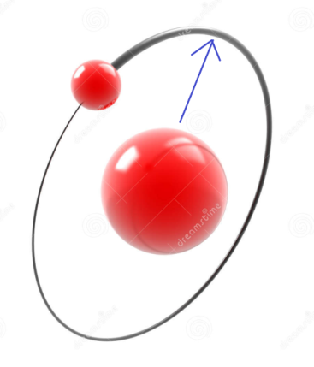
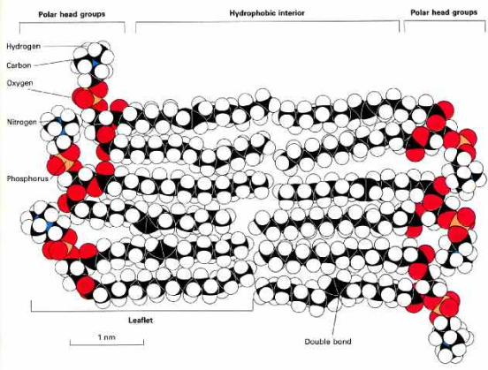
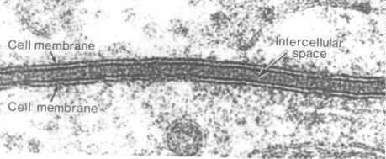
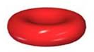
Thinking About Size
Hydrogen atom radius
0.5 Å = 50 pm = 0.05 nm = 5 × 10⁻¹¹ m
Cell membrane bilayer
5 nm = 50 Å = 5 × 10⁻⁹ m = 100 × H atom radius
Red blood cell
7 µm = 7000 nm = 70,000 Å = 7 × 10⁻⁶ m = 140,000 × H atom radius

Slide 28
Size & Geometry
Larger cells have lower surface area-to-volume ratios
given a spherical cell: volume (r³) increases more rapidly than surface area (r²) as a cell gets larger
Biomolecules diffuse in, out and through the cell
Cell can only be as big as the biomolecules vital to its survival can efficiently be at physiologically important locations
Rate of diffusion dependencies
cell surface area
concentration gradients
temperature
traversal distance

Slide 29
Size Limitations
Cell must have enough surface area to accommodate nutrients entering and wastes exiting for its volume
Cell must not be so big such that limits on nutrient and waste substance diffusion causes a stressful (toxic/deficient) condition
Biochemical reactions depend on maintaining adequate concentrations of reactants and enzymes, more easily done in a smaller containing space than a larger one

Slide 30
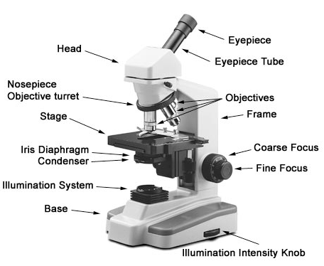
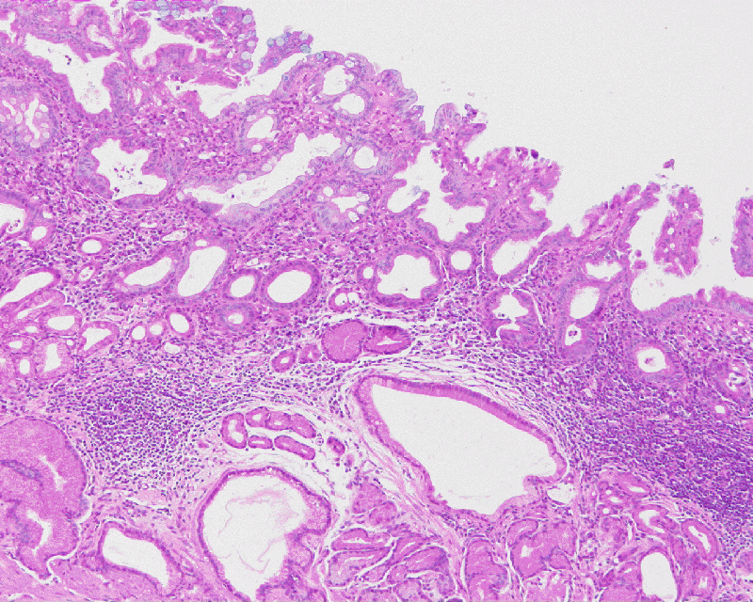
Seeing Structure: Light Microscopy
Light Microscopy
resolution barely below 1 µm
brightfield
must use stains to provide contrast
would use to see stained tissue sections
e.g. hematoxylin-and-eosin (H&E) of
stomach wall (figure)
phase contrast
imaging living cells in culture/fluid medium
http://www.nikon.com/products/instruments/resources/tech/guide/overview/img/pic_06.jpg

Slide 31
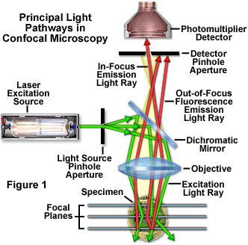
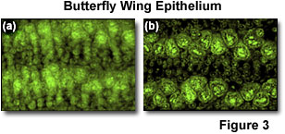
Seeing Structure: Light Microscopy
confocal
reduces flare problem in fluorescence microscopy
able to focus within narrow field of depth
creates sharper images
can generate 3D images with rapid automated positioning

Slide 32
Seeing Structure: Electron Microscopy
Transmission Electron Microscopy (TEM)
specimens fixed (dehydrated & embedded in resin/plastic) are sectioned in an ultra-microtome (50-100 nm thick), then coated/stained with electron-dense, electron-scattering metal salts (often lead or uranium) to improve contrast
Best magnifications: resolve objects separated by 0.2 nm
Scanning Electron Microscopy (SEM)
specimens fixed & dehydrated resin/plastic) then coated/stained with electron-dense, electron-scattering metal salts (gold/palladium) to improve imaging
Best magnifications: resolve objects separated by 10 nm

Slide 33
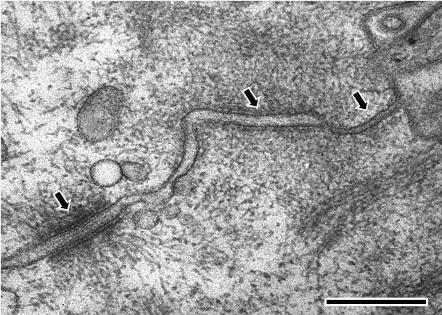
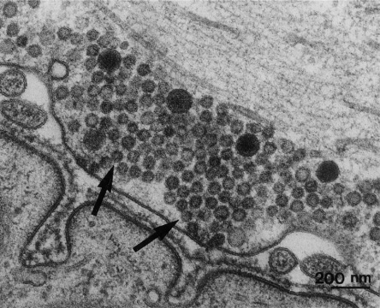
TEM Examples
http://starklab.slu.edu/neuro/nmj.jpg
http://www.mechanobio.info/figure/1384242441141.jpg.html
Electron microscopy image of rat intestinal mucosa epithelial cell-cell junctions. The cell is orientated such that the top right hand corner is apical and the bottom left hand corner is more basal. .From left to right; the first arrow points to a desmosome with dense desmosomal plaques seen either side of the intercellular space of approximately 240 angstroms in width, the second arrow points to an adherens junction with an intercellular space of approximately 200 angstroms and the third arrow points towards a tight junction that shows close apposition of the plasma membrane leaflets, as inferred from the absence of an intercellular gap. (Scale bar 250 nm).
TEM of a neuromuscular junction, with axon terminal containing numerous vesicles on top and evaginated folds to increase surface contact with muscle cell on bottom. Electron-dense material is in the intercellular space

Slide 34
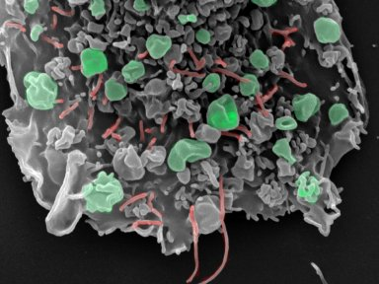
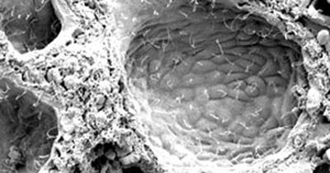
SEM Examples
http://www.lincoln.ox.ac.uk/Undergraduates-Subjects-Medicine
http://www.mayo.edu/research/~/media/kcms/gbs/research/images/2013/05/19/11/02/cilated-cholangiocytes-index.ashx
Scanning electron micrograph of ciliated cholangiocytes lining each liver cyst in an autosomal recessive polycystic kidney disease animal model.
Scanning electron micrograph of the effect the human breast cancer-associated gene has on cell behavior. The budding vesicles (green) generate fragments of cancer cell that can be detected in the blood and the adhesion processes (red) are altered making the cell less attached to its surroundings and more able to migrate to distant sites.

Slide 35
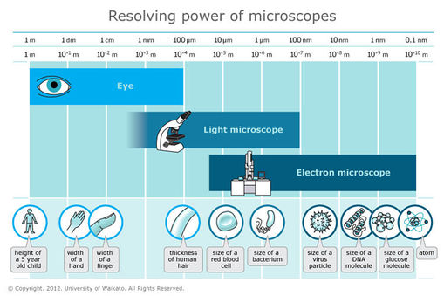

Slide 36
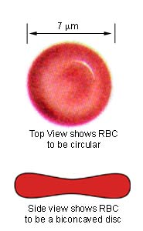
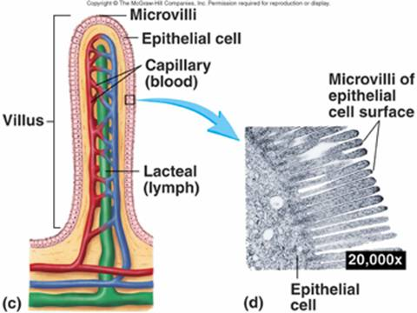
Structure-Function Optimization
Erythrocyte
Disk-shaped with biconcavity
Optimized for rapid association and dissociation of O₂ with the heme group enveloped by hemoglobin polypeptides within the RBC
Intestinal Epithelial Cell
situated on an intestinal villus to improve nutrient absorption
its apical (luminal) surface has microvilli to further improve nutrient absorption
http://www.biosbcc.net/doohan/sample/images/blood%20cells/RBC.jpg
http://www.rci.rutgers.edu/~uzwiak/AnatPhys/Digestive_System_files/image030.jpg

Slide 37
Subcellular Structures
Organelles ("little organs")
Mitochondria
Endoplasmic Reticulum (ER) / Endomembrane sys
"rough ER" (RER)
"smooth ER" (SER)
Golgi complex / apparatus
Lysosomes
Peroxisomes

Slide 38
Subcellular Structures
Other specialized features
Ribosomes (organelle?)
subunit macromolecular assemblies of dozens of proteins weaved around RNA polymers
Cytoskeleton
microfilaments, microtubules, intermediate filaments
Centrioles
Cilia
Flagella
Microvilli

Slide 39
Cells Are "Living"
Cells are the fundamental "unit" of "life" – the living thing
the organism can be a single cell or multicellular
Viruses
appear life-like in that they can perpetuate their existence in large numbers, replicate selves
without host cells, they cannot: no free-living existence
same applies to viroids and prions

Slide 40
Reading (Sources)
Marieb: part I of chapter 3
Becker's WotC: Chapter 4
Raven: Chap 4.2, 4.3,

Slide 41
Chemistry Review: Reactivity, Bonds, Reactions, Enzymes, Water
Lecture 2

Slide 42
Quick Drive Through Chemistry
Atom: structure/properties
Interacting ("bonded") atoms: molecules and such
Electrons: orbitals atomic and molecular
Quantum nature of chemistry lightly discussed
Relationship of Periodic Table to biological science

Slide 43
The Atom
Atoms are made of three subatomic particles
Protons
which actually give the element its identity
Electrons
chemistry is really about electrons, because it is electrons that allow atoms to bond to each other
Neutrons
it takes about 1800 electrons to equal mass of a proton, and the neutron is slightly bigger than the proton by 0.15%.
Because neutrons have a mass that is slightly higher than sum of a proton & electron, and because neutrons have been shown to decay to a proton, electron, and some other particles in physics, speculation is that a neutron is special gluing of a proton and electron.

Slide 44
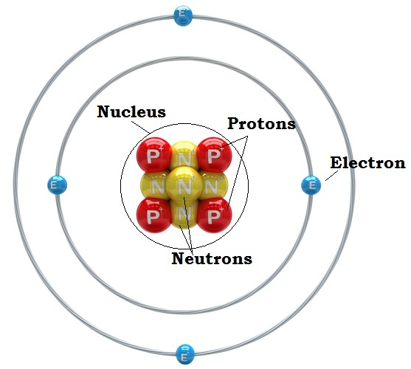
Nucleus & Orbitals
Protons and neutrons organized in the nucleus
Electrons spatially located outside of the nucleus
Electrons "orbit" the nucleus in orbitals but not like planets revolving around the sun
Their position/location is determined by probabilities calculated by complex mathematical expressions
Each orbital pairs two electrons of opposite spin
Yes, electrons have a spin just as the Earth rotates on an axis, and this spin generates a magnetic field

Slide 45
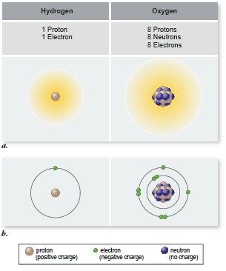
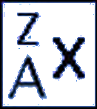
Elements
Elements all have the same number of protons
But elements can have different number of neutrons
An element with different numbers of neutrons is an isotope of the element
When referring to an isotope of an element, use this
Where
X is element symbol (e.g, hydrogen = H)
A is atomic number, = # protons (A = 1 for H)
Z is mass number, = #protons + #neutrons

Slide 46
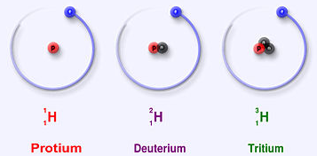
Hydrogen
Hydrogen has three isotopes:
Protium (¹₁H)
1 proton, 0 neutrons
usually just called "hydrogen"
99.9885% of all hydrogen isotopes in nature is this isotope
Deuterium (²₁H)
1 proton, 1 neutron
It is a stable isotope
0.0115% of hydrogen isotopes is deuterium in nature
Tritium (³₁H)
1 proton, 2 neutrons
It is an unstable isotope, meaning it is radioactive
Probably less than 0.00000001% in natural abundance

Slide 47
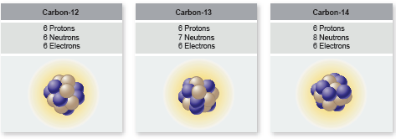
Carbon
Organic chemistry is the chemistry of carbon
Total of 6 electrons in two shells (n =1 and n = 2)
Will use 4 electrons in its valence shell to bond with other atoms
Other atoms it bonds with in biological organisms:
H, N, O, and other C atoms mostly
S, P atoms also

Slide 48
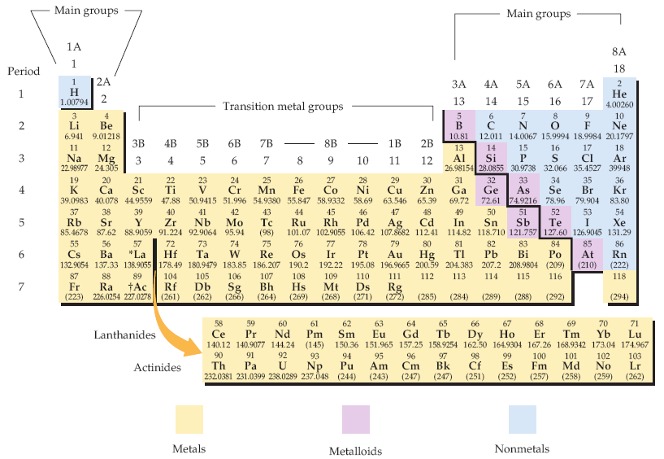
Periodic Table of Elements
Biologists should know what elements are (1) metals and (2) nonmetals generally
The periodic table of the elements. Each element is identified by a one- or two-letter symbol and is characterized by an atomic number. The table begins with hydrogen (H, atomic number 1) in the upper left-hand corner and continues to the yet unnamed element with atomic number 118. The 14 elements following lanthanum (La, atomic number 57) and the 14 elements following actinium (Ac, atomic number 89) are pulled out and shown below the others.
Elements are organized into 18 vertical columns, or groups, and 7 horizontal rows, or periods. The two groups on the left and the six on the right are the main groups; the ten in the middle are the transition metal groups. The 14 elements following lanthanum are the lanthanides, and the 14 elements following actinium are the actinides; together these are known as the inner transition metals. Two systems for numbering the groups are explained in the text. Those elements (except hydrogen) on the left-hand side of the zigzag line running from boron (B) to astatine (At) are metals, those elements to the right of the line are nonmetals, and most elements abutting the line are metalloids.
McMurry et al, Fundamentals of General, Organic and Biological Chemistry, 6 Ed, p 58

Slide 49
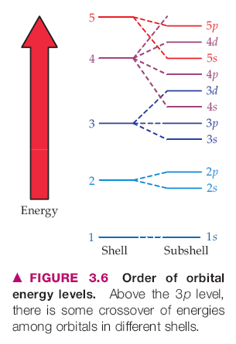
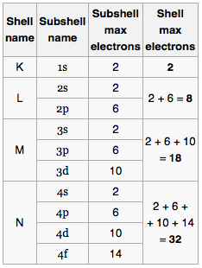
Shells of Electrons & Periodic Table
Each period (row) of the Periodic Table corresponds to a "shell" of electrons
Shells are designated by the principal quantum number n by chemists: n = 1, 2, 3, …
letters K, L, M, N, O, … by physicists
Within the shells are subshells: s, p, d, f
In quantum chemistry/physics, each electron is described by a set of four quantum numbers: {n, l, m_{l}, m_{s}}
There is a correspondence between a shell's energy and its shell number/letter (distance from nucleus): higher shell number relates to higher energy of the electron
The maximum number of electrons in each shell (period) is 2, 8, 8, 18, 18, 32, 32, ..

Slide 50
The Valence Shell
The outermost shell of electrons is where all the chemistry happens
Atoms want to have "complete" shells
This means shedding or giving up electrons if there are too few
Grabbing electrons from other atoms if they need only a few
Giving up electrons means acquiring a positive + charge
Grabbing electrons means acquiring a negative – charge
In forming molecules or crystals, atoms form complete stable shells by having the complete set of electrons in their valence shell, whether or not they share them with other atoms

Slide 51
Electronegativity
The affinity of an atom for one or more electrons
The factors affecting electronegativity are
atom's need to acquire electrons to complete shell
size of atom: smaller atoms more electronegative
decreasing order: F, O, Cl, N, Br, I, C, S, Se, H, P
Differences in electronegativity account for type/character of bonding (shown in later slide)

Slide 52
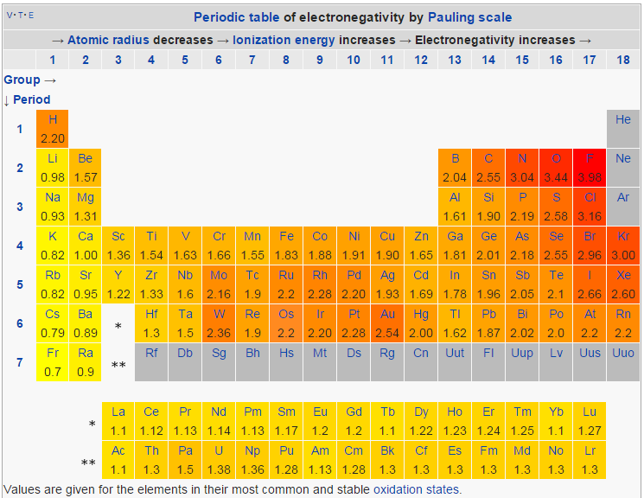
Electronegativity Quantitated
http://en.wikipedia.org/wiki/Electronegativity

Slide 53
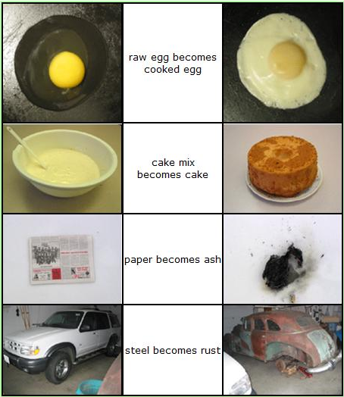
Chemical Reactions
Bond breaking and formation
Movements of electron (singly or as pairs) from one atom or molecule to another
Atoms or molecules acquiring electrical charges positive or negative (or losing them: uncharged)
Common, daily chemical reactions
https://wikis.engrade.com/science1012011/chemicalreactions

Slide 54
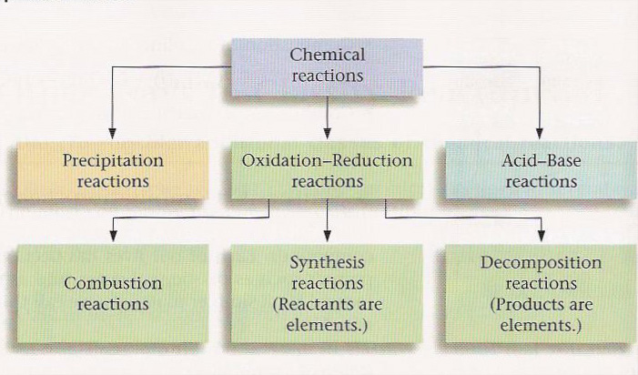
Types of Chemical Reactions
6 Types of Reactions
Combustion C₁₀H₈ + 12 O₂ → 10 CO₂ + 4 H₂O
Synthesis 8 Fe + S₈ → 8 FeS
Decomposition 2 H₂O → 2 H₂ + O₂
Single Displacement Mg + 2 H₂O → Mg(OH)₂ + H₂
Double Displacement Pb(NO₃)₂ + 2 KI → PbI₂ + 2 KNO₃
Acid-Base HBr + NaOH → NaBr + H₂O
http://quinton.pbwiki.com/f/textbookfig712edit.jpg

Slide 55
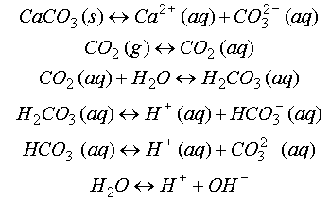
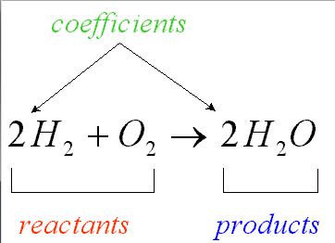
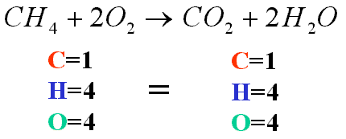
Balancing Mass & Charge
Laws of conservation of mass and electrical charge require that chemical (reaction) equations be balanced for mass and charge
http://ion.chem.usu.edu/~sbialkow/Classes/3600/Overheads/Carbonate/image020.gif
http://www.mikeblaber.org/oldwine/chm1045/notes/Stoich/Equation/balance4.gif

Slide 56
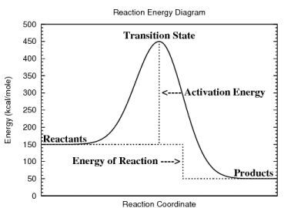
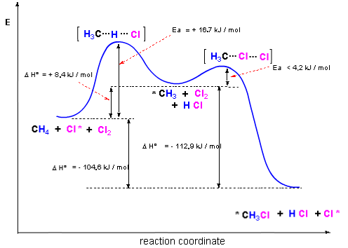
Reaction Energy Diagrams
Diagrams show changes in the (potential) energy along a "reaction coordinate"
A reaction coordinate is basically a state of the reaction: reactants, activated complexes or transition states, products
Often show detail of energy values
http://www.personal.kent.edu/~cearley/gen50/review/rxnEnergy.png

Slide 57
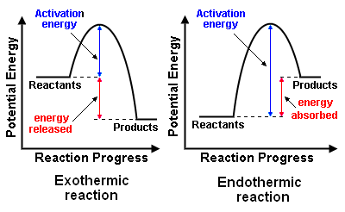
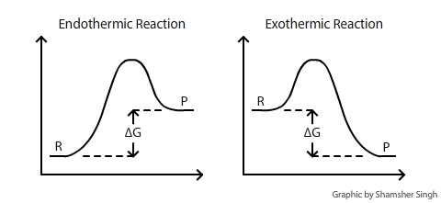
Endothermic & Exothermic
Exothermic Reactions reactions releasing energy: work done, heat released
gasoline combustion
Endothermic Reactions reactions requiring energy: put them on the hot plate
dissolving urea in water
http://chemwiki.ucdavis.edu/@api/deki/files/120/delta_g_diagram.png
http://en.citizendium.org/images/f/fb/ExoEndo_Reax.png

Slide 58
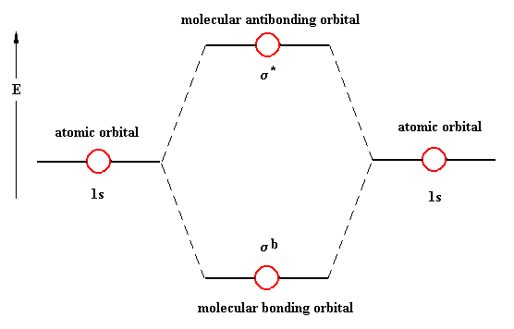
Bonding
Atoms bond using electrons
remember: chemistry is really about the electrons
Electrons in atomic orbitals (AOs) come together between atoms in molecular orbitals (MOs), forming a bonding MO
MOs have two paired (opposite spin) electrons just like AOs
s subshell AOs form σ (sigma)-type MOs (bonds)
p subshell AOs form π (pi)-type MOs (bonds)
there are anti-bonding MOs: they are an excited state type of orbital which, when filled with electrons, actually result in bond-breaking between atoms, not bond-making

Slide 59
Bonding Types & Strength
Type | Description | Strength (kcal/mol)
Ionic / Electrostatic | One atom gives up its electron(s) to another which really wants them: the result is ionized atoms bonding because of electrical attraction (unlike charges) | 50-150
Covalent | Two atoms share the electrons in the bond, neither having a strongly competitive affinity for the electrons (small difference in electronegativity) | 50-100 (single) 100-200 (double) 200-250 (triple)
Hydrogen Bonding | The hydrogen (H) atom is "shared" between two more electronegative atoms | 2-10
Hydrophobic | A "bonding" driven by solvent with polar molecule (H₂O) that prefers to bond to itself (oil & water don't mix) | ND
van der Waals | bonding caused by "induced polarity" from one molecule to another causing a temporary weak electrical attraction | 0.5-1.0

Slide 60
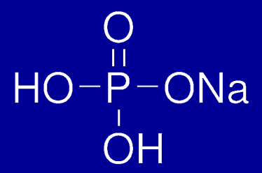
The Covalent Bond
Two atoms that share equally the pair(s) of electrons
Atoms bonding with selves (diatomic molecules) should always be covalent H₂, O₂, N₂, F₂, Cl₂, Br₂, I₂
Can be single, double, and triple bonds between atoms
H₃C—CH₃ (ethane) sigma bond
H₂C=CH₂ (ethene) sigma + pi bond
HC≡CH (ethyne/acetylene) sigma + 2 pi bonds
H—H, O=O, N≡N, F—F, Cl—Cl, Br—Br

Slide 61
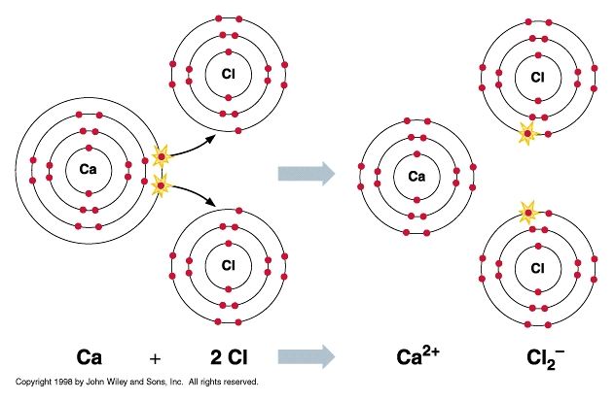
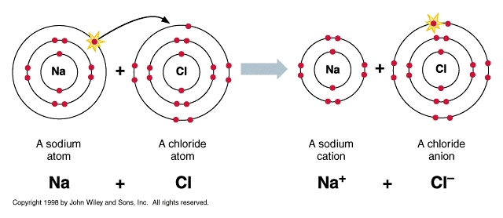
The Ionic / Electrostatic Bond
The bond created by an electrostatic attraction between positive and negative charges resulting from the complete transfer of electrons from one atom to another Na → Na⁺ + e– Cl + e– → Cl– --------------------------------- Na + Cl → Na⁺ + Cl–

Slide 62
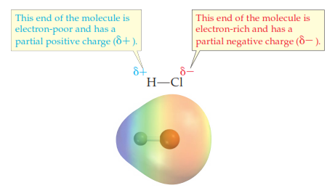
A Polar Covalent Bond
A type of bond that has a mix of covalent and ionic character
The difference in electronegativity of atoms is not such that one atom fully grabs another
Bonds that are polar covalent: O–H, N–H, H–Cl/F (list shown later)
The polar covalent bond accounts for the hydrogen bond

Slide 63
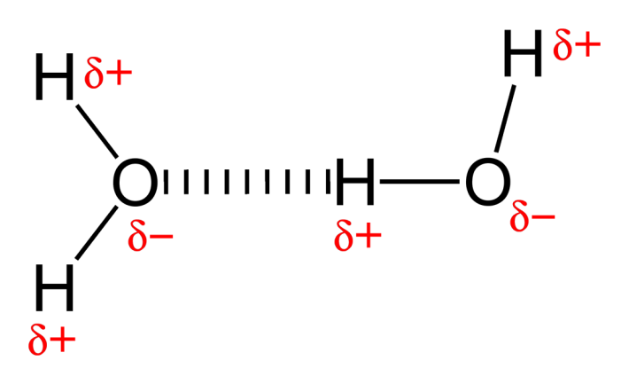
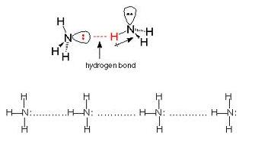
The Hydrogen Bond
The bonding of an H atom already covalently bonded to a more electronegative atom to another more electronegative atom on different molecule
The presence of (a) nonbonding electron pairs in the more electronegative atom is a factor
The presence of N–H and O–H groups in countless biomolecules makes the hydrogen bond significant in all aspects of biochemistry
The double-strandedness of DNA and RNA is because of H-bonding. Polypeptide folding in proteins makes use of H-bonding

Slide 64
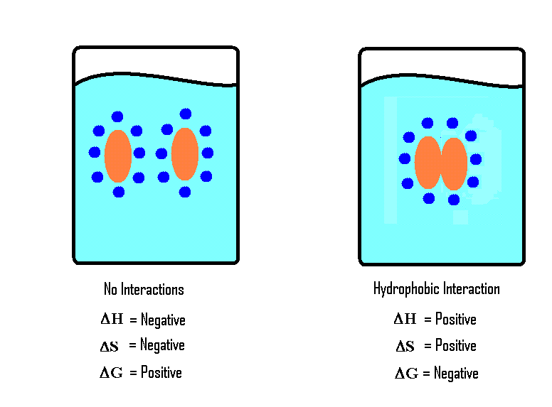
Hydrophobic Interactions
There are no real forces between molecules in hydrophobic molecules associating or clustering together
Instead, the free energy (G) of the solution favors water bonding with itself (by H-bonding) rather than interacting with molecules with which it has no affinity
http://chemwiki.ucdavis.edu/@api/deki/files/8648/image9.GIF

Slide 65


van der Waals Forces
The spatial location of negative charge ("electron cloud") is not perfectly radially distributed about the spherical atom at each moment in time
This transient change in charge symmetry in one atom affects neighboring atoms

Slide 66

Spectrum of Sharing
Covalent ←→ Polar Covalent ←→ Ionic bonding is a spectrum of atomic affinity for electrons
The spectrum is evidenced by the differences of the electronegativity of atoms
(Nonpolar) Covalent
N—O, diatomic forms (H₂, O₂, N₂), C—H, C—S
Polar Covalent
O—H, N—H, O—C, N—C, O—P
Ionic
Metal + nonmetal: Na+ –Cl, K+ –Cl, Na+ –OH,

Slide 67
Electronegativity Values
H: 2.20 , C: 2.55 , O: 3.44, N: 3.04, P: 2.19 S:2.58
Criteria: Electronegativity Difference (Δ)
Δ < 0.4: covalent
0.4 < Δ < 2: polar covalent
Δ > 2: ionic
Common Bonded Atoms in Biology
O—H 3.44 – 2.20 = 1.24 polar covalent
C—H 2.55 – 2.20 = 0.35 covalent
C—O 3.44 – 2.55 = 0.99 polar covalent
C—N 3.04 – 2.55 = 0.49 polar covalent
N—H 3.04 – 2.20 = 0.84 polar covalent
P—O 3.44 – 2.19 = 1.25 polar covalent
C—S 2.58 – 2.55 = 0.03 covalent
S—O 3.44 – 2.58 = 0.86 polar covalent

Slide 68
Ions
electrically charged atoms and molecules
ionized atoms: Na⁺, Cl–, K⁺, Ca²⁺, Mg²⁺
ionized molecules
H₃O⁺, HPO₄^{2–}, NH₄⁺ C₄H₄O₄^{2–} (succinate: molecular formula) –OOC-CH₂-CH₂-COO– (succinate: structural formula)
cations: positively charged ions
move toward cathode (– pole)
anions: negatively charged ions
move toward anode (+ pole)

Slide 69
The Molecule
Atoms that are covalently bonded to each other
Ionic compounds (and their solid forms crystals) (e.g. NaCl, table salt) are not molecules because the bonding is not covalent
A group of bonded atoms that are all non-metal atoms is a molecule

Slide 70
Organic Chemistry
Functional Groups (moieties)
alkyl (methylene –CH₂-)
alkenyl (-CH₂=CH₂-)
double-bond geometry (cis- or Z-, trans- or E-)
hydroxyl (R-OH)
carbonyl (aldehydes, ketones) (-C=O)
aminyl (-NH₂)
carboxyl (-C[=O]-OH)
esteryl (-C[=O]-O-R)
amidyl (-C[=O]-NH-R)

Slide 71
Substance Quantitation
prefixes: giga 10⁹, mega 10⁶, kilo 10³, deca 10¹, deci 10^{–1}, centi 10^{–2}, milli 10^{–3}, micro 10^{–6}, nano 10^{–9}, pico 10^{–12}, femto 10^{–15}, atto 10^{–18}
Mass
units: grams, kilograms, moles, # molecules
not weight!
Conversions:
When balancing or determining yields from chemical equations, always convert to moles first
Volume
units: cubic ___meters: cm³, mm³, L(iters)
Conversions: 1 mL = 1 cm³, 1 L = 1000 ml

Slide 72
Substance Quantitation
Solution Density (Concentration)
units: G/L, mol/L, M, %(w/v), %(v/v), ppm, etc, etc
mass of a solute in the volume of a solution
solution = solute + solvent
note density = mass/volume, but of a pure substance!
mass of solute = concentration × volume
stock solutions / reagents
[ g ←AW/MW→ mole ] weighed out: add solvent to final volume
dilutions: C_{concentrated} ×V_{concentrated} = C_{dilution} × V_{dilution}

Slide 73



H₂O – Structure
O atom more electronegative
greater affinity for electrons
both bonding and nonbonding electrons (electron pairs)
O-H bond covalent ("shared" bonding electrons) but polar
Garrett & Grisham, Biochemistry (5ed, 2013)
Lehniinger, Biochemistry (4ed, 2005)

Slide 74


Water – Hydrogen Bonding
H-bonding: the H atom covalently bonded to an O atom in one H₂O molecule forms a weak bond with one of the two unbonded pairs in the valence shell of the O atom of another H₂O molecule
A "weak" bond is a relatively lower energy bond than the covalent bond, but still significant
Water (liq H₂O) forms at temperatures < 100°C with H bonds
These are broken when water boils

Slide 75


H₂O Phases
ice: H-bonded in a less dense space
water: H-bonds formed & unformed rapidly in more dense space
vapor: no H-bonding as they gallivant through space
animation shows H₂O as water solvating a chloride ion. Note yellow flashes are H-bonds forming & unforming

Slide 76
Water – Properties
High specific heat 1 cal/g/°C
This enables water to resist changes in temperature when heat energy enters or exits
Polar
A great many organic and inorganic solutes dissolve in it, providing the environment for biochemical reactions
Cohesive because of the H-bond
Water's surface tension resists loss of solvent as well as accounts for capillary flow exploited by organisms
Organisms composed of 70-90% water

Slide 77

Catalysis
A substance that promotes a chemical reaction by lowering its activation energy (E_{a})
Note that this does not change the relative potential energies of the reactants or products (ΔE)

Slide 78
Enzymes – Nature's Catalysts
Without enzymes, must use high temperatures to enable biochemical reactions
Classically proteins: one or more polypeptides
polypeptides: amino acid polymers
when > 1 polypeptide: "subunits"
natively folded
can include non-protein "cofactors" & "coenzymes"
many metal cations: Ca²⁺, Mg²⁺, Fe²⁺, Zn²⁺, Cu²⁺
vitamins typically pre-activated co-enzymes
pyridoxal (B₆), thiamine (B₁), riboflavin (B₂), cyanocobalamin (B₁₂)

Slide 79
Reading (Sources)
Marieb: Chapter 2
Becker's WotC: Chapter 2
Raven: Chap 2

Slide 80
Chemistry Review: Inorganic Components of The Cell
Lecture 3

Slide 81
Hydrogen Ion Concentration
In aqueous solutions (including cytoplasm of cells), the hydrogen ion concentration [H⁺] is important since it can affect biochemical reactions
Water is a weak acid (acids donate protons H⁺)
It is also a base (bases accept protons)
Water can donate protons to itself:
H₂O + H₂O ←→ H₃O⁺ + OH–
←→ is supposed to mean that there is a forward and reverse reaction
The reaction is often shown as this H₂O ←→ H⁺ + OH–
In pure water, the H⁺ concentration reaches 10^{–7} moles per liter = 10^{–7} molar = 10^{–7} M
This also implies that the [OH–] = 10^{–7} M

Slide 82
K_{w} & pH
An equilibrium constant K is the ratio of the concentratin of all products divided by concentration of all products
So the equilibrium constant for water, Kw, is
K_{w} = [H⁺][OH–] = [10^{–7}][10^{–7}] = 10^{–14}
Definition: pH = –log[H⁺]
for pure water: –log 10^{–7} = 7

Slide 83
Mineral Acid
Hydrochloric acid (HCl) is an example of a strong acid
whenever any uses term "mineral" acid, they imply strong acid
Strong acids when added to water completely react with water molecules (which act as bases) to form hydronium ions (H₃O⁺)
HCl + H₂O → H₃O⁺ + Cl–
Most just leave out the fact that a proton (H⁺) is transferred to an accepting base (H₂O) and write:
HCl → H⁺ + Cl–

Slide 84
Mineral Acid
If we add 1 mole HCl to 1 liter H₂O, all of the protons in HCl contribute to the [H⁺] concentration (100% ionization)
So we have [H⁺] = 1 M, and so the pH = –log 1 = 0
If we added 0.001 mole to 1 L water, then
[H+] = 0.001 M, so pH = –log 0.001 = 3

Slide 85
Mineral Bases
Sodium hydroxide (NaOH) is an example of a strong (mineral) base
It produces OH– ions immediately, lowering the [H⁺]
As OH– and H⁺ are in an equilibrium with H₂O and affected by its equilibrium constant K_{w}
Suppose we add 1 mol NaOH to 1 L H₂O, which produces [OH–] = 1 M. What is the [H⁺] and pH?
K_{w} = 10^{–14} = [H⁺] [OH–]
the math says [H⁺] = 10^{–14} M, so pH = 14
Now suppose we prepare 0.001 M NaOH. The math says [H+] = 10^{–11} M, so pH = 11

Slide 86
Weak Acids & Bases
Unlike HCl, weak acids do not completely give up their protons
Acetic acid (CH₃COOH) is an example of a weak acid: when added to water, not all of it ionizes (gives H⁺ to the solution)
Unlike NaOH, weak bases do not completely take up protons in solution
Ammonia (NH₃) is an example of a weak base

Slide 87
Buffers
HA ←→ H⁺ + A–
if HA = HCl, then [HA] = 0 (no HA left)
if HA = CH3COOH, there is much HA remaining
B + H⁺ ←→ BH⁺
if B = NaOH, then [B] = 0 (no NaOH left)
if B = NH3, there is much B remaining
If you add HCl to just water, you get a change in pH that is dependent just on the H⁺ produced by HCl
But if you add HCl to water containing a high concentration of CH₃COOH, the H⁺ resists changing because of the weak acid present
This makes weak acids and bases good buffers.
A buffer is a chemical that resists a change in pH when lots of H+ or OH– ions are produced

Slide 88
Buffering in the Body
The pH of all body fluids, inside and outside of the cells, must be maintained in a narrow range or else enzymes stop doing metabolism
Cytosolic pH values

Slide 89
Physiological Extremes of pH
Within cells: membrane-bound lysosomes particularly within phagocytic immune cells (neutrophils) will produce an internal pH of about 2: shown by enzymes that work in the lysosome having a maximal activity at that low pH
At organ/system level: it is well known that parietal cells in the stomach are engines that pump H⁺ into the gastric fluid for digestion, and that enzymes like pepsin have maximal activity at these low pH values

Slide 90
Osmosis
The movement of water (H₂O molecules) across a water-permeable, solute-impermeable barrier (membrane) as a result of differences in solute concentrations across the two sides of the barrier
Water will move towards the side with the greater solute concentration until there is an equilibrium
This movement and equilibrium are explained using chemical potential energy equations in thermodynamics

Slide 91
Tonicity
isotonic (isotonicity n.)
refers to the property of a medium (solution) in which the total chemical constituents (molecules, ions) have concentrations that will cause no significant osmosis in or out of a living cell posing a threat to its survival
hypertonic
the medium (solution) outside the cell has a total concentration of salts that it causes water to leave the cell, shrinking the cell
hypotonic
the medium (solution) inside the cell has a total concentration of salts that it causes water to enter the cell, causing it to enlarge greatly, and likely bursting ("lysing") the cell

Slide 92

Effects of Tonicity
Rather extreme forms of stress with inorganic constituent imbalances
Animal cells have no cell wall, so can be lysed in a hypotonic medium
Plant cells have a right cell wall that protects them from being lysed; nonetheless function can be severely affected

Slide 93
Osmolarity

Slide 94

From molecular to cellular
polymerization of the small molecule monomer to a macromolecule
macromolecular assembly
supramolecular interaction to an organelle
Becker WotC p 28

Slide 95
Extracellular Medium

Slide 96
Intracellular Medium

Slide 97
Macronutrients
Macronutrients
Ca
S
P
Mg
Fe

Slide 98
Micronutrients
Many of the transition metals not in the first two groups of the periodic table
Molybdenum (Mo2+): found in many oxygenase-type enzymes

Slide 99
Neuronal Excitability
Neuronal function depends on not merely an isotonic environment, but a precise concentration of specific ions across the membrane moving against their chemical potential (gradient)

Slide 100
Reading (Sources)
Becker's WotC: Chapter 2
Raven: Chap 2
Marieb: pp 40-42

Slide 101
Chemistry Review: Organic Components—Carbohydrates and Proteins
Lecture 4

Slide 102
Terms / Definitions / Descriptions
Hydrolysis ("cutting with water")
A chemical reaction in which H₂O is used in the bond breaking of a molecule into two distinct molecules, one taking an H atom and the other the OH atom
Condensation
in chemistry, it refers to the opposite of hydrolysis: joining two chemicals in a way that H₂O is released
both hydrolysis and condensation happen a lot in biochemistry
Polymer
A molecule made up of many repeating smaller molecules ("monomers") bonded together in a chemical reaction (polymerization). Polymeric forms of biochemicals are ubiquitous in biological organisms

Slide 103
Terms / Definitions / Descriptions
Isomer
A form of a molecule that can have many different structures while the number of the kinds of atoms is identical
C₂H₅O: diethyl ether is an isomer of ethanol

Slide 104
Carbohydrates
Have the simple empirical formula CH₂O
1:2:1 C:H:O
Carbohydrates are "sugars"
polyhydroxy (poly –OH) aldehydes (aldoses)
aldehydes have this structure:
R groups are usually rest of molecule, where next bonded atom is C
polyhydroxy ketones (ketoses)
ketones have this structure:

Slide 105
Glucose
The most important monosaccharide (sugar) in all of biology is glucose
C₆H₁₂O₆
Made in photosynthesis by leaves of plants
6 CO₂ + 6 H₂O + sunlight → C₆H₁₂O₆ + 6 O₂
Broken down in respiration by eukaryote cells
C₆H₁₂O₆ + 6 O₂ → 6 CO₂ + 6 H₂O + energy (stored as ATP)

Slide 106
Other Monosaccharides
The monosaccharides range in molecular size from the 3-carbon glyceraldehyde to 7-carbon heptuloses
Galactose combines with glucose to form the disaccharide lactose ("milk sugar")
Fructose combines with glucose to form the disaccharide sucrose (table sugar)
In cells, mono- and polysaccharides occur in the ring form

Slide 107
Some Monosaccharide Structures
Galactose is a C-4 epimer of glucose
An epimer is an isomer

Slide 108
Glucose As A Polymer
The most important monosaccharide (sugar) in all of biology is glucose
C₆H₁₂O₆
Made by plants in photosynthesis
Broken down in respiration by all eukaryotic cells

Slide 109
Glycogen
When glucose is not utilized in metabolism, it needs to be stored
In animals, the best storage form is glycogen
Glycogen is a highly branched polymeric form of glucose
Glycogen is stored in liver & skeletal muscle typically

Slide 110
Starch
Starch is just like glycogen in that it is a polymer of glucose used as a storage form for glucose
Starch is a branched form of glucose polymer, although less branched than glycogen
Starch is the storage form for plants
Since animals consume plants, they have evolved a set of digestive (hydrolytic)

Slide 111






A Combined Carbon & Oxygen Cycle in Biology
photosynthesis
combustion
C₆H₁₂O₂
C_{n}H_{2n+2}
O₂
O₂
H₂O
CO₂
H₂O
O₂
Colored oxygen atoms show you how the "labeled" oxygen atoms move from molecule to molecule in the cycle
CO₂
C₆H₁₂O₂
respiration

Slide 112
Special Mention: Ribose & 2-Deoxyribose
Ribose is a 5-carbon sugar (aldose)
Ribose is used in the backbone of RNA
Its 2-deoxyribose form is used in the backbone of DNA
This yellow background information box is shown for your information, and is not required to be memorized for assessment purposes

Slide 113

The Amino Acid
Has four basic parts in the chemical structure
The "central" alpha-carbon
this carbon is "chiral," meaning it is bonded to 4 different groups and thus has stereochemistry
The amino (–NH₂) group
this group will bond with the –COOH group to form the peptide bond
The carboxyl (–COOH) group
this group will bond with the –NH₂ group to form the peptide bond
The side ("R") group/chain
this has 20 different possible groupings of atoms
The amino acid L-alanine in 3D (R-configuration)

Slide 114
The Natural Amino Acids
There are 20 natural amino acids in eukaryotes
The side chain of the amino acid gives it its special chemistry and name
Because amino acids make up the sequences of polypeptides, biologists/biochemists have created special 1- and 3-letter abbreviations used when discussing proteins
The chemistry of the side chain allows amino acids to be classed differently
ionic/electrostatic
polar
non-polar, hydrophobic

Slide 115
The Amino Acid
 | 3-letter abbr. |  | 1-letter abbr. | MW | Side-chain structure | pK_{a}
Non-polar Amino Acids
Alanine |  | Ala | A | 89.1 |  | 2.35 | α-COOH
 |  |  |  |  |  | 9.69 | α-NH₂
Valine |  | Val | V | 117.1 |  | 2.32 | α-COOH
 |  |  |  |  |  | 9.62 | α-NH₂
Leucine |  | Leu | L | 131.2 |  | 2.36 | α-COOH
 |  |  |  |  |  | 9.6 | α-NH₂
Isoleucine |  | Ile | I | 131.2 |  | 2.36 | α-COOH
 |  |  |  |  |  | 9.68 | α-NH₂
Phenylalanine |  | Phe | F | 165.2 |  | 1.83 | α-COOH
 |  |  |  |  |  | 9.13 | α-NH₂
Tryptophan |  | Trp | W | 204.2 |  | 2.38 | α-COOH
 |  |  |  |  |  | 9.39 | α-NH₂
Methionine |  | Met | M | 149.2 |  | 2.28 | α-COOH
 |  |  |  |  |  | 9.21 | α-NH₂
Proline |  | Pro | P | 115.1 |  | 1.99 | α-COOH
 |  |  |  |  |  | 10.6 | α-NH-

Slide 116
The Amino Acid
 | 3-letter abbr. |  | 1-letter abbr. | MW | Side-chain structure | pK_{a}
Polar Amino Acids
Glycine |  | Gly | G | 75.1 |  |  | 2.34 | α-COOH
 |  |  |  |  |  |  | 9.6 | α-NH₂
Serine |  | Ser | S | 105.1 |  |  | 2.21 | α-COOH
 |  |  |  |  |  |  | 9.15 | α-NH₂
Threonine |  | Thr | T | 119.1 |  |  | 2.63 | α-COOH
 |  |  |  |  |  |  | 9.15 | α-NH₂
Cysteine |  | Cys | C | 121.2 |  |  | 1.71 | α-COOH
 |  |  |  |  |  |  | 8.33 | side chain
 |  |  |  |  |  |  | 10.78 | α-NH₂
Tyrosine |  | Tyr | Y | 181.2 |  |  | 2.2 | α-COOH
 |  |  |  |  |  |  | 9.11 | α-NH₂
Asparagine |  | Asn | N | 132.1 |  |  | 2.02 | α-COOH
 |  |  |  |  |  |  | 8.8 | α-NH₂
Glutamine |  | Gln | Q | 146.1 |  |  | 2.17 | α-COOH
 |  |  |  |  |  |  | 9.13 | α-NH₂

Slide 117
The Amino Acid
 | 3-letter abbr. |  | 1-letter abbr. | MW | Side-chain structure | pK_{a}
Ionic Amino Acids
Aspartic Acid |  | Asp | D | 133.1 |  |  | 2.09 | α-COOH
 |  |  |  |  |  |  | 3.86 | side chain
 |  |  |  |  |  |  | 9.82 | α-NH₂
Glutamic Acid |  | Glu | E | 147.2 |  |  | 2.19 | α-COOH
 |  |  |  |  |  |  | 4.25 | side chain
 |  |  |  |  |  |  | 9.67 | α-NH₂
Lysine |  | Lys | K | 146.2 |  |  | 2.18 | α-COOH
 |  |  |  |  |  |  | 10.53 | side chain
 |  |  |  |  |  |  | 8.95 | α-NH₂
Arginine |  | Arg | R | 174.2 |  |  | 2.17 | α-COOH
 |  |  |  |  |  |  | 12.48 | side chain
 |  |  |  |  |  |  | 9.04 | α-NH₂
Histidine |  | His | H | 155.2 |  |  | 1.82 | α-COOH
 |  |  |  |  |  |  | 6.00 | side chain
 |  |  |  |  |  |  | 9.17 | α-NH₂

Slide 118
Chemical Bonding In The Polypeptide
Ionic (Electrostatic)
Ser
Glu
H-bonding
Cys
Ile
Asn
Cys
Covalent (disulfide)
Lys
Hydrophobic
Leu

Slide 119
The Peptide Bond

Slide 120
Polypeptides
Polypeptides are the single molecule that represents the polymer of amino acids
They have a directionality
an amino terminus
also often written as N-terminus or NH₂-terminus
a carboxyl terminus
also often written as C-terminus or COOH-terminus
usually sequences are written left to right where the left end is the N-terminus and the right is the C-terminus
Polypeptides are synthesized from the N-terminus to the C-terminus as well

Slide 121
Protein Chemistry

Slide 122
Protein Structure
Proteins have four levels of structure
Primary (1°)
Secondary (2°)
Tertiary (3°)
Quaternary (4°)

Slide 123
Primary Structure of Proteins
This is the amino acid sequence itself
The amino acids and the order they appear have most, if not all, the information to direct the folding of the polypeptide to its higher levels of structure

Slide 124
Secondary Structure of Proteins
These are special structural formations of the polypeptide that are created by atoms in the backbone of the polymer (polypeptide) forming hydrogen bonds with other atoms in the backbone
alpha helix
beta sheet

Slide 125
Tertiary Structure of Proteins
These are special structural formations of the polypeptide that are created by atoms in the backbone of the polymer (polypeptide) forming hydrogen bonds with other atoms in the backbone
alpha helix
beta sheet

Slide 126
Quaternary Structure of Proteins
After the polypeptide completes its three levels of structure, it may associate with other polypeptides that are identical with it or different from it
These are multi-subunit proteins

Slide 127
The Complete Protein
Remember, the protein represents a single functional entity
It might be composed of a single polypeptide

Slide 128
Various Functions (Purposes) of Proteins
Enzymes
Proteins that perform (bio)chemical reactions
hexokinase: phosphorylates glucose when it enters cell
Na,K-ATPase: uses ATP energy to move Na⁺ & K⁺ across membranes
Structural Proteins
Proteins that build walls or form a framework
cytoskeletal proteins: tubulin, actin

Slide 129
Membrane Proteins
Proteins attached to or embedded in proteins
Proteins that span the membrane include many types
Receptors
Transporters
Channels

Slide 130
Receptors
Proteins attached to or embedded in proteins
Proteins that span the membrane include many types
Receptors
Transporters
Channels

Slide 131
Transporters
Proteins attached to or embedded in proteins
Proteins that span the membrane include many types
Receptors
Transporters
Channels

Slide 132
Channels

Slide 133
Terms / Definitions / Descriptions
monomer
polymer
polypeptide

Slide 134
Reading (Sources)
Marieb: Chapter 2, pp 43-45, 49-53
Becker's WotC: pp 41-53, 60-65
Raven: Chapter 3.2, 3.4

Slide 135
Chemistry Review: Lipids
Lecture 5

Slide 136
Lipids ("Fats")
Lipid classes
Triglycerides: storage lipids
used as "food"
catabolized to yield calories for ATP for other processes
Phospholipids

Slide 137
Terms / Definitions
Lipophilic ("fat-loving") and Hydrophobic ("water-fearing) generally have the same meaning

Slide 138
The Fatty Acid
Lipid classes
Triglycerides: storage lipids
used as "food"
catabolized to yield calories for ATP for other processes
Phospholipids

Slide 139

Saturated Vs. Unsaturated FA
In the long

Slide 140
Glycerol
A 3-carbon polyhydroxy (poly-OH) alcohol that is fundamental in lipids important in biology
Remember in organic chemistry, an alcohol has the structure R-OH
Glycerol as 3 R-OH groups
Glycerol is found as an intermediate in many metabolic pathways, particularly in lipid metabolism (catabolism and biosynthesis)

Slide 141
The Fatty Acid Ester
In organic chemistry, the condensation of a fatty acid with an alcohol produces an ester
Condensation is the opposite of hydrolysis: H2O is taken out
In the reaction below, a common fatty acid (16-carbon palmitate) is esterified with glycerol

Slide 142
Triglycerides
Triglycerides are simply three fatty acids that are esterified to the three –OH (alcohol) groups of glycerol
Triglycerides are often stored within cells fo
Adipose tissue contains cells whose primary function

Slide 143
Polar Lipids
Polar lipids means one part is

Slide 144
Phospholipids
Lipid classes
Triglycerides: storage lipids
used as "food"
catabolized to yield calories for ATP for other processes
Phospholipids

Slide 145
Reading (Sources)
Marieb: Chapter 2: pp 45-49
Becker's WotC: Chapter 3: pp 66-70
Raven: Chap 3.5

Slide 146
Cell Membrane Structure & Function
Lecture 6

Slide 147
Cell Membrane Function
Cell membrane

Slide 148
Reading (Sources)
Becker's WotC: Chapter 7
Raven: Chap 5.1, 5.2
Marieb: Chapter 3: pp 65-66

Slide 149
Cell Signaling & Receptors
Lecture 7

Slide 151
Reading (Sources)
Marieb: Chapter 2
Becker's WotC: Chapter 14
Raven: Chap 2

Slide 152
Cell Junctions
Lecture 8

Slide 154
Reading (Sources)
Becker's WotC: Chapter 17: 481-487
Raven: Chap 4.8
Marieb: Chapter 3: p 67

Slide 155
Cell Membrane Transport: Passive Transport
Lecture 9

Slide 157
Reading (Sources)
Becker's WotC: Chapter 2
Raven: Chap 5.4
Marieb: Chapter 2

Slide 158
Cell Membrane Transport: Active Transport (part 1 of 2)
Lecture 10

Slide 160
Reading (Sources)
Marieb: Chapter 2
Becker's WotC: Chapter 2
Raven: Chap 2

Slide 161
Cell Membrane Transport: Active Transport (part 2 of 2)
Lecture 11

Slide 163
Reading (Sources)
Becker's WotC: Chapter 5.5
Raven: Chapter 5.5
Marieb: Chapter 2

Slide 164
Bulk Transport
Lecture 12

Slide 166
Reading (Sources)
Becker's WotC: Chapter 2
Raven: Chap 5.6
Marieb: Chapter 2

Slide 167
Metabolism & ATP (Part 1 of 2)
Lecture 13

Slide 168
Bioenergetics

Slide 169
Metabolism

Slide 170
ATP

Slide 171
Glycolysis

Slide 172
Tricarboxylic Acid Cycle

Slide 173
Respiration (Electron Transport)

Slide 174
Fermentation

Slide 175
Reading (Sources)
Marieb: Chapter 2
Becker's WotC: Chapter 2
Raven: Chap 2

Slide 176
Metabolism & ATP (Part 2 of 2)
Lecture 14

Slide 177
Catabolic Metabolism

Slide 178
Lipid Catabolism

Slide 179
Lipid Biosynthesis

Slide 180
Polysaccharide Biosynthesis

Slide 181
Reading (Sources)
Marieb: Chapter 2
Becker's WotC: Chapter 2
Raven: Chap 2

Slide 182
Cell Organelles: Mitochondria, Endoplasmic Reticulum, Golgi Complex, Lysosomes, Peroxisomes
Lecture 15

Slide 183
Mitochondria

Slide 184
Endoplasmic Reticulum

Slide 185
Golgi Complex

Slide 186
Lysosomes

Slide 187
Peroxisomes

Slide 188
Reading (Sources)
Marieb: Chapter 2
Becker's WotC: Chapter 2
Raven: Chap 2

Slide 189
Cell Organelles: Microfilaments, Microtubules, Nucleus, The Cell Cycle
Lecture 16

Slide 190
Microfilaments

Slide 191
Microtubules

Slide 192
The Cell Nucleus

Slide 193
The Cell Cycle

Slide 194
Reading (Sources)
Marieb: Chapter 2
Becker's WotC: Chapter 15
Raven: Chap 2

Slide 195
Nucleic Acids & Chromosomes
Lecture 17

Slide 196
Nucleic Acids

Slide 197
Chromosome
The way the cell organizes its genome
Has special mechanisms for creating genetic variation in sexual reproduction
recombination

Slide 198
Genome Defined

Slide 199
Diploid Defined

Slide 200
Haploid Defined

Slide 201
Gene Defined

Slide 202
Allele Defined

Slide 203
Genotype Defined

Slide 204
Phenotype Defined

Slide 205
Reading (Sources)
Marieb: Chapter 2
Becker's WotC: Chapter 2
Raven: Chap 2

Slide 206
Protein Synthesis
Lecture 18

Slide 207
The expression of the genome
Biomolecules that make up structure, mediate binding co-location of other molecules, enable chemical reactions (catalysis)

Slide 208
Reading (Sources)
Marieb: Chapter 2
Becker's WotC: Chapter 2
Raven: Chap 2

Slide 209
Mitosis
Lecture 19

Slide 210
Controlled, organized effort to reproduce genome within a nucleus
Cell division is different process although synchronized
Bacteria do NOT undergo mitosis

Slide 211
Reading (Sources)
Marieb: Chapter 2
Becker's WotC: Chapter 2
Raven: Chap 2

Slide 212
Meiosis
Lecture 20

Slide 213
Production of gametes (sex cells)
Two stage process to change "ploidy"
Recombination events provide diversity

Slide 214
Reading (Sources)
Marieb: Chapter 2
Becker's WotC: Chapter 2
Raven: Chap 2

